Slide 1
Uncertainty Quantification for Cyber-Physical Pressurized Water Reactor Experiments
Dr. Taylor K. McKenzie (PI)
Co-authors: Dr. Christopher Lamb, Dr. Thomas D. Tarman
Notes:
Hi and thanks for joining! I’m Taylor McKenzie and today I’ll be discussing this study into Uncertainty Quantification for Cyber-Physical Pressurized Water Reactor Experiments.

Slide 2
Introduction
Ph.D. in Economics from University of Oregon in 2017
Studied Industrial Organization, choice modeling, empirical models of competition
Dissertation identified changes in pricing, competition, and technological change in US freight rail industry following deregulation
Joined Sandia National Laboratories in 2017
Cyber risk and resilience analysis: Statistical analysis and uncertainty quantification to measure risk to/resilience of cyber-physical systems using emulation and experimentation
Interagency Nuclear Safety Review Board: Risk analyses of launches of spacecraft containing nuclear material, including Mars 2020/Perseverance
Strategic Futures and Policy Analysis: Telecommuting/hybrid work posture, COVID-19 economic impact analyses, Global Futures studies on Economic Value & National Security and Knowledge Management
Notes:
Before kicking off, I’ll give just a brief introduction and some context for where this research fits.
I received my Ph.D. in Economics from the University of Oregon in 2017, where I studied industrial organization and focused on choice modeling and empirical models of competition. My dissertation focused on identifying changes in pricing, competition, and technological change in the US freight rail industry following its partial deregulation.
I joined Sandia National Laboratories in 2017, and I started in a group doing Cyber Resilience R&D. While I was in that role, I contributed to and conducted analysis looking at risk and resilience of cyber systems, and specifically performing statistical analyses and uncertainty quantification that enabled using cyber emulation and experimentation to measure risk and resilience. This is where the research I’ll be discussing mostly fits in.
During that time, I also joined the Interagency Nuclear Safety Review Board, which performs risk analyses of launches of spacecraft containing nuclear material. Through 2019, our work was focused on Mars 2020 and the Perseverance rover, which landed on Mars in 2020, and since then have been preparing for analysis of a nuclear thermal propulsion mission, which is starting up this year.
Then in early 2020 I joined the Strategic Futures and Policy Analysis group here at Sandia. I actually shifted roles one week before lockdown, so was able to jump right in into some policy studies looking at Telecommuting that ultimately shaped Sandia’s hybrid work posture and economic impact analyses that supported Sandia’s COVID modeling effort. And, amongst other research, I’ve been involved with Sandia’s Global Futures series, which considers domains and areas where there could be disruptions over the next 10-20 years that would have major implications for Sandia strategy and national security as a whole. In particular, I was one of the PIs on the Future of Economic Value and National Security and am the lead PI the current study on the Future of Knowledge Management.

Slide 3
Agenda
Uncertainty quantification for cyber-physical pressurized water reactor experiments (McKenzie et al. 2020) [1]
Background and system description
Research problem and uncertainty quantification approach
Kernel smoothing and Gaussian process approaches
Results
Discussion and impacts
Notes:
To give you an idea of what we have planned: Again, I’ll be discussing this paper, “Uncertainty quantification for cyber-physical pressurized water reactor experiments”, which was presented at the International Conference on Nuclear Engineering in 2020. I really enjoy talking about this research because there’s a good story to tell about the research process, some good lessons learned about not taking assumptions for granted, and I think is a good look into what cyber emulation and experimentation is about and how uncertainty quantification is often an integral part of that process.
So I’ll start off with a bit of background into this research and application area, broadly what cyber emulation is, and I’ll also cover some of the important details of pressurized water reactor systems.
I’ll then talk through our specific research problem and why uncertainty quantification is needed and broadly what uncertainty quantification is aiming to do.
Next, I’ll go into a couple of specific uncertainty quantification approaches we considered for this application. I’ll discuss kernel smoothing, which was initially promising but ended up being a failed approach, at least in its standard form, due to some peculiarities of the data we’ll discuss. I’ll also discuss Gaussian processes, which are functionally similar to kernel smoothing but have some unique advantages for this particular application, and are what we ultimately opted for in this particular case.
I’ll then talk through some of our results and finish with a discussion on extensions and improvements as well as the impacts this work had.

Slide 4
Background and System Description

Slide 5
Background
Sandia has significant capabilities in cyber-physical emulation environments
The SCEPTRE platform was developed to “analyze how cyber-initiated events affect the physical world,” using a network emulation with hardware-in-the-loop capabilities to model, test, and validate cyber-physical systems [2]
Used to assess risk and resilience of cyber-physical systems to natural and adversarial disruptions. Systems studied include critical infrastructures (e.g., power, oil/gas, chemical), space/satellite systems, industrial control systems (ICSs).
This project was funded by sponsors from DOE-NE, who were interested in the risk posed to cyber-physical nuclear power generation
Specifically interested in metrics to evaluate risk of catastrophic outcomes given a particular attack scenario
Cyber-physical emulation is particularly well-suited for this analysis
Nuclear reactor mechanics/dynamics are well understood and high-fidelity simulation models exist for these systems
Cyber risk to nuclear reactor systems is less understood and more difficult to simulate with needed fidelity
Notes:
So to start off, Sandia has developed significant capabilities into cyber-physical emulation environments. I’ll talk through this bit on broadly what the goals of these capabilities are, and will talk more about how we define emulation in the next slide. In particular, the SCEPTRE platform was developed at Sandia to “analyze how cyber-initiated events affect the physical world,” using a combination of network emulation and hardware-in-the-loop capabilities to model, test, and validate cyber-physical systems. SCEPTRE has been used to assess risk and resilience of cyber-physical systems to a range of both natural and adversarial disruptions, with systems including various critical infrastructures like power, oil and gas, and chemical facilities, space and satellite systems, and industrial control systems in general.
This project was funded by sponsors from DOE-NE, and they were interested, broadly, in assessing risk posed to cyber-physical nuclear power generation. In particular, they were looking for ways to measure risk of catastrophic outcomes given a particular attack or disruption scenario.
And again, I’ll talk more about what emulation is in the next slide, but as it turns out, cyber-physical emulation is a good choice for this analysis. In particular, nuclear reactor mechanics and dynamics are well understood and computer simulations are a great approximation to the actual systems. On the other hand, cyber risk, and in particular how cyber events propagate to and interface with physical events, is less understood. So, we rely on emulating cyber components and using, for example, real software and network protocols (Modbus).

Slide 6
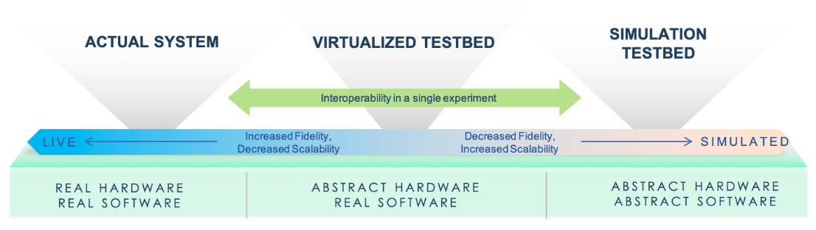
Emulation and Cyber Experiments
We want to evaluate how a critical system would respond to a given disruption
Quantify impacts
Identify and quantify effectiveness of mitigation strategies
Affecting operations of a critical system is infeasible
Emulation provides ability to create a sufficient representation of a system, including hardware in the loop
Emulation can be used to see how actual system would respond without affecting operations
Parameters of the system, emulation, or disruption may be uncertain
Thus, outcomes are also uncertain and can be described by a probability distribution
Uncertainty quantification (UQ) involves propagating input uncertainty to determine/approximate the distribution of outcomes
Notes:
So, in research that draws on emulation, we’re wanting to evaluate how a critical system would respond to a given disruption. And we’re doing this to both quantify impacts of a disruption as well as identify and quantify the effectiveness of potential mitigation strategies.
Now with most or all critical systems, doing anything that might affect the operations of the actual system is not an option. So, we need to rely on some model of the system to give us an idea of what impacts might look like.
Turning to the graphic on the bottom of the slide, what emulation is trying to do is bridge this gap between the actual system and a fully abstracted representation of that system. Emulations will use abstract representations of components for which simulations are adequate or where things like scale or cost make using an actual version of that component infeasible. So, in practice, we frequently simulate (use an abstract representation of) hardware, physical processes and physical system dynamics, things like power system models and reactor dynamics. Then, for components for which there’s not a great simulation, we use actual representations for those components. These frequently include software components and the protocols that pieces of the system use to communicate with each other. And finally, there’s an interface between the abstract hardware and real software that completes the representation of the system as a whole.
So, emulation providing this ability to create a sufficient model of the system, allowing to simulate using representations where it makes sense and its convenient, and use real representations in other cases where we need that fidelity. And those real representations can be anything from actual software and protocols to real hardware that we can plug into the loop. Overall, this gives us the ability to create a model that’s as high-fidelity as is feasible and makes sense that enables us to have a good view into how the actual system would respond.
The issue is, a model is just that, and parameters of the system, emulation, or disruption may be uncertain. And therefore outcomes are also uncertain and are described by an unknown probability distribution. Uncertainty quantification, or UQ, in its most general form involves propagating uncertainty in inputs to determine or approximate the distribution of outcomes.

Slide 7
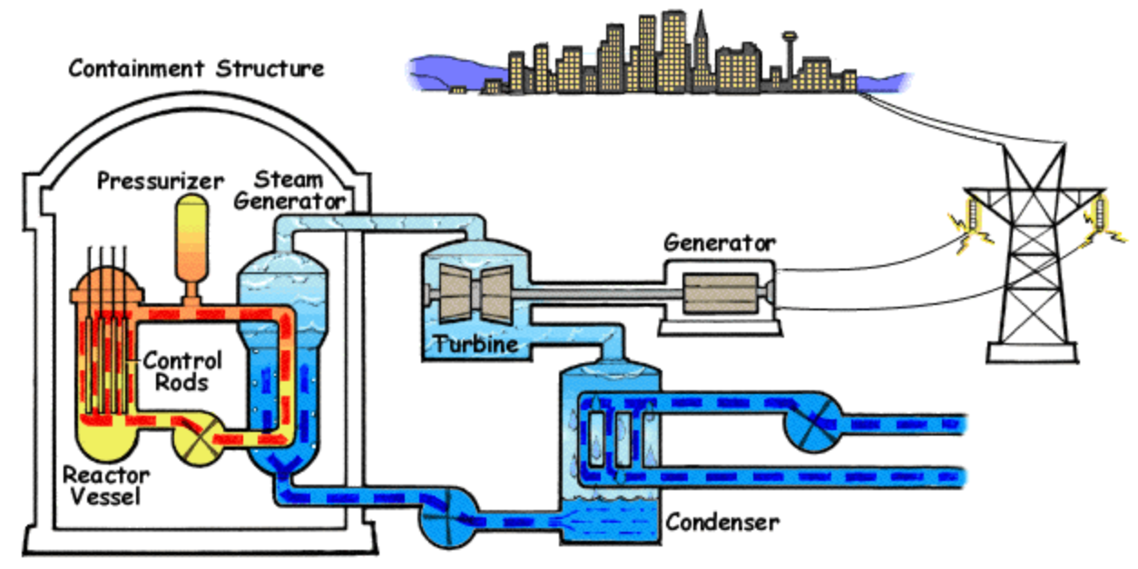
Proof of Concept System: Pressurized Water Reactor
Image sources: NRC, Wikipedia
Notes:
Before really diving into the research problem, let’s talk more about pressurized water reactors, or PWRs. PWRs are a very common nuclear reactor design, accounting for about 65% of nuclear power generation in the United States in 2021. This graphic comes from the Nuclear Regulatory Commission and shows a general PWR design.
What makes PWRs unique is a dual coolant loop design. In the figure, you’ll see a red/orange/yellow loop which is called the primary loop, and a blue loop that includes the steam generator, turbine, and condenser which is called the secondary loop. In the primary loop, coolant (which is most commonly water) is used to moderate nuclear reactions occurring in the reactor and cool the reactor. As coolant in the primary loop is circulated, it heats coolant in the secondary, which produces steam that drives a turbine and is then recondensed back into water. Now, this dual loop design is convenient because it only requires significant radioactive containment coolant in the primary and, notably, not the coolant that’s driving the turbine. Also, what’s called “heavy water” may be used in the primary because it’s an exceptional moderator of nuclear reactions, but is much more expensive than “regular” water and isn’t necessarily what you want to use to drive a turbine, for example.
Now, the primary loop is pressurized to allow the coolant to reach much higher temperatures without turning to gas. In general, coolant turning to gas unexpectedly (“flashing to steam”) can be catastrophic because that can lead to large, unpredictable swings in pressure that can damage pipes, vessels, and other components. For context, the primary is typically kept at a temperature of about 345C and a pressure of 15-16 Mpa (just below the triple point of water).

Slide 8
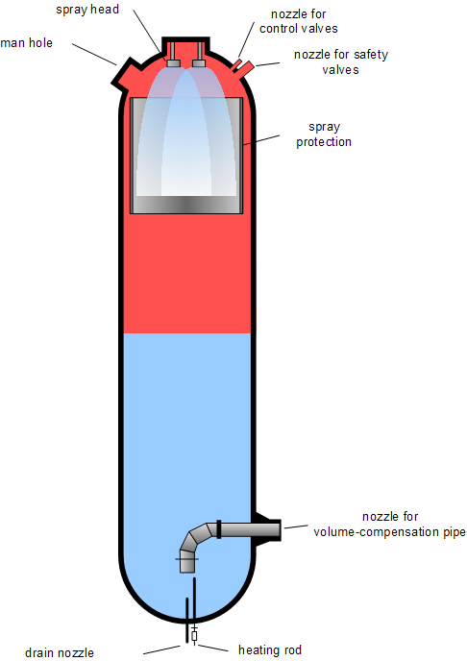
Proof of Concept System: Pressurized Water Reactor
Image sources: NRC, Wikipedia
Notes:
To maintain pressure in the primary loop, a pressurizer sits on top of the primary and is the only component of the primary loop that does (should) contain gas. Pressure of the entire loop is controlled by changing pressure of gas in the pressurizer. There are electric variable heaters that increase the heat and pressure of the pressurizer, and there are sprayers that spray relatively cool water in the pressurizer and reduce temperature and pressure.
So, as you might imagine, the pressurizer is a critical component of the primary loop and overall PWR system. If pressure is allowed to get too low, water could flash to steam and damage pipes, vessels, and other components. If pressure gets too high, components of the system could also be damaged, albeit probably in a less dramatic way but catastrophic nonetheless.
Before moving on, are there any questions about PWR systems in general?

Slide 9
Proof of Concept System: Pressurized Water Reactor
Pressurized water reactors (PWRs) are a nuclear reactor design with the following characteristics:
Two coolant loops:
Primary loop where coolant cools and moderates the reactor
Secondary loop where coolant is heated by the primary and generates steam that drives turbines
Pressurized primary loop, which allows coolant to reach high temperatures while remaining liquid
Typical pressure: ~15-16 MPa
Typical temperature: ~345 °C
In a dual coolant loop design, only coolant in the primary loop requires significant radioactive containment
Pressurizer sits on the primary coolant loop and maintains appropriate pressure
Too low could allow water to flash to steam. Too high could damage vessels/pipes/components.
Electric heaters increase temperature/pressure, water sprayers reduce temperature/pressure
Pressurizer is a critical component of the system, and failures are highly consequential
Dual loop design is unique to PWRs, motivating risk analysis specific to PWRs
PWRs are a very common design, accounting for 65% of nuclear power generation in the U.S. in 2021 [3]
Notes:
This slide is just writing out what I said in words in the last couple slides, just here for your reference.

Slide 10
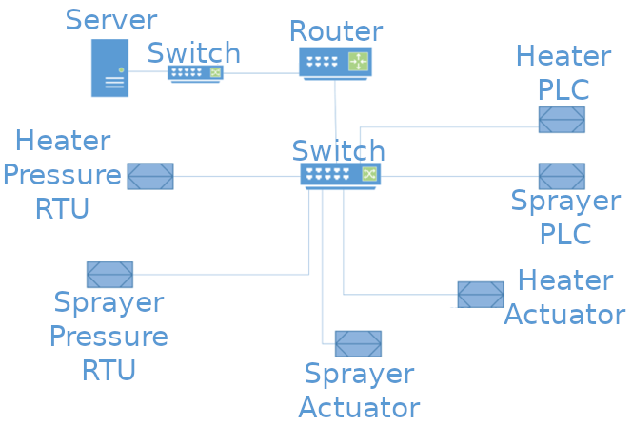
Proof of Concept System: Cyber-Physical PWR System
We draw on a cyber-physical emulation of a PWR system
Abstract hardware: Pressurizer (including electric variable heaters and spray valves to control pressure) described by numerical model implemented in Simulink
Real software: Supervisory control and data acquisition (SCADA) system, including server, router, network switches, remote terminal units (RTUs) to interface with pressure sensors, and programmable logic controllers (PLCs) to actuate heaters/sprayers
Notes:
SCADA system includes virtualized hardware components, but those components are speaking to each other/using the same protocols as real components
So the in last couple slides, we talked through the physical PWR system, but of course we’re working with a cyber-physical PWR system; that is, one that includes some cyber components to observe and control physical processes. This slide shows a representation of the cyber network we built and used.
Again, we’re leveraging an emulation, which aims to make most hardware components abstract through simulation and uses real representations of software components. The hardware we’re abstracting is the pressurizer, which is described by a numerical model implemented in Simulink and, of course, includes electric variable heaters and spray valves to control pressure. On the other side, we’re using real software for the supervisory control and data acquisition, or SCADA, network, which includes a server, router, network switches, remote terminal units, or RTUs, to interface with pressure sensors, and programmable logic controllers, or PLCs, to actuate the heaters or sprayers. Finally, the interface between the real network and simulated pressurizer are the actuators, which change pressure in the simulation, and RTUs, which provide pressure data back to the SCADA system.

Slide 11
Research Problem and Uncertainty Quantification Approach

Slide 12
Research Problem
In general, previous risk/resilience analyses, red team assessments, and intelligence can be used to form a distribution of disruptions
For this analysis, attacks will continually inject a specified control value to the pressurizer heater and/or sprayer. The injected values and which component(s) are targeted are assumed to be random.
Given a distribution of attacks, our goal is to estimate the probability that a catastrophic outcome will occur
Severe consequences can occur if differential pressure on the pressurizer exceeds 1 MPa
Emulation is computationally expensive, making simple Monte Carlo analysis infeasible
Need to use methods that can accommodate limited numbers of observations while correctly express uncertainty
Uncertainty quantification (UQ) methods can be used to estimate outcomes and evaluate uncertainty in those estimates when obtaining additional observations is costly
Notes:
So now let’s get into the specific research problem. So, in general, a distribution of disruptions can be approximated or established through previous risk and resilience analyses, red team assessments, and intelligence. Or, for natural disasters for example, you might look at historic data. We’ll talk more about specifics of the attack in the next slide, but to give you a look ahead, the attacks in this study involve overriding the control values being sent to heater and sprayer PLCs, which goes on to affect how the heater and sprayer are actuated (how they’re acting). What will be random are which components are targeted (the heater and/or sprayer) and what values are injected to the targeted components.
So, our goal with this research is to, given a distribution of attacks, estimate the probability that a catastrophic outcome will occur. In particular, so differential pressure is the difference between the target pressure (which is 16 MPa) and actual pressure. Severe consequences can occur if that differential pressure exceeds 1 MPa. Now, a simple way we could approach this problem is to do a simple Monte Carlo; we would pick some random attack parameters from the attack distribution, run the emulation, and see if differential pressure ever exceeded 1 MPa, then repeat that process many times until we have an adequate sample of outcomes. However, the issue is that the emulation is computationally- and especially time-intensive (with each iteration taking around 7 minutes to run). So, we just don’t have time to use simple Monte Carlo and also have a sufficient number of observations in our sample. So, we need to use a method that accommodate limited numbers of actual observations and correctly express uncertainty in the distribution of outcomes.
Uncertainty quantification, or UQ, methods have been developed to address this exact problem. We’ll discuss UQ more in a couple slides, but broadly these methods are trying to understand a distribution of outcomes when obtaining observations is costly in terms of time or other resources.

Slide 13
Disruption and Quantities of Interest
Disruption:
An attacker is assumed to have gained access to the SCADA network and is able to override control values being fed to the heater and/or sprayer
The SCADA network is assumed to not have any intrusion detection or prevention system
The attacker is assumed to target either heater, sprayer, or both, each with probability 1/3
The attacker continuously injects malicious values to targeted actuator(s) for two minutes. Injected values are constant over the attack and are assumed to be uniformly distributed over [0, 100].
Notes:
Next, before talking more about UQ, let’s talk through the disruption we used for this research. We assumed that there is a malicious attacker who gained access to the SCADA network and is able to override control values being fed to the heater and/or sprayer. The SCADA system is assumed to not have any intrusion detection or prevention system, so the attacker isn’t worried about disguising their network traffic or limiting how frequently they’re sending control values. The attacker is assumed to target either the heater, the sprayer, or both heater and sprayer, each with probability 1/3. And finally, the attacker continuously inject malicious control values to the targeted actuators for two minutes. Those injected values are constant over the attack and are assumed to be uniformly distributed over the interval 0 to 100, where 0 is off and 100 is fully on for the heater or sprayer.
Now this attack is relatively simple, but that was intentional as this is kind of a proof of concept. If we had a more realistic distribution of attacks, possibly including different attack vectors, we could still go through a very similar process. But also, there is some realism here, as the pressurizer is a component that an attacker may want to target, and of course the heater and sprayer are the vector to affect the pressurizer.

Slide 14
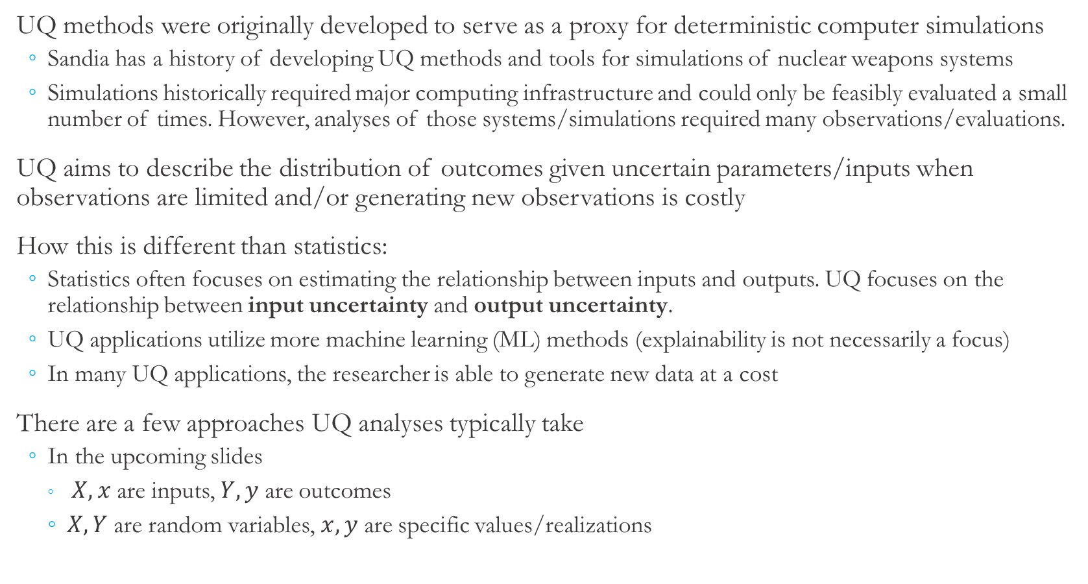
UQ vs. Statistics
UQ methods were originally developed to serve as a proxy for deterministic computer simulations
Sandia has a history of developing UQ methods and tools for simulations of nuclear weapons systems
Simulations historically required major computing infrastructure and could only be feasibly evaluated a small number of times. However, analyses of those systems/simulations required many observations/evaluations.
UQ aims to describe the distribution of outcomes given uncertain parameters/inputs when observations are limited and/or generating new observations is costly
How this is different than statistics:
Statistics often focuses on estimating the relationship between inputs and outputs. UQ focuses on the relationship between input uncertainty and output uncertainty.
UQ applications utilize more machine learning (ML) methods (explainability is not necessarily a focus)
In many UQ applications, the researcher is able to generate new data at a cost
There are a few approaches UQ analyses typically take
In the upcoming slides
$X,x$ are inputs, $Y,y$ are outcomes
$X, Y$ are random variables, $x, y$ are specific values/realizations
Notes:
So, coming from a statistics background, when I first heard the term “uncertainty quantification”, I immediately wondered “how does that differ from statistics?” because both are answering pretty interrelated questions and sometimes are using similar tools. So, hopefully this will provide at least some clarity to those who are from a similar background.
So, UQ methods saw a lot of development early on to serve as a proxy for deterministic computer simulations. In particular, Sandia has a lot of interest in this area because we have simulations of things like nuclear weapons systems, and these are very computationally-intensive physics-based simulations. And so it was really only feasible to evaluate these simulations a relatively small number of times. UQ methods were developed to try to describe a distribution of outcomes these simulations given potentially random or uncertain inputs to the simulation, especially in situations where the researcher can generate new observations but its very costly to do so.
Now, UQ is different from statistics in a few ways, mostly related to different motivations between the two fields. So, statistics is frequently interested in describing relationships inputs and outputs; sometimes we’re after a causal relationship or sometimes just correlational, but the focus is on the relationship and how certain we are that a relationship exists. UQ is a bit more general, and, at least in its most basic form, is only concerned with the relationship between input uncertainty and output uncertainty. Any relationship between particular inputs and particular outputs is secondary and not strictly necessary. Now, there are cases where those relationships might be interesting and useful, so the researcher has to think about whether capturing those relationships is worthwhile.
Next, even in cases where we are trying to capture the relationship between inputs and outputs, things like explainability and causality are really not the focus, the focus is mostly or entirely on prediction. So, we tend to see more machine learning methods being applied in UQ than we do in statistics.
Finally, often in statistics, and especially in areas like the social sciences and economic statistics, the dataset is often fixed and the researcher isn’t able to go out and get more observations, and especially isn’t able to get new observations in a targeted way. It’s very frequently the complete inverse scenario in UQ. The researcher usually is able to generate new observations, and it’s costly to do so, but the researcher can potentially select input values in a smart way to reduce uncertainty in the outcome distribution (that is, the Monte Carlo uncertainty that results from having a small Monte Carlo sample).
So, in the next few slides, we’re going to go through a few different approaches that UQ analyses typically take. Just for notation, the X’s will denote inputs and Y’s will denote outputs. Upper case variables are random variables and lower case variables are particular values or realizations of those random variables.

Slide 15
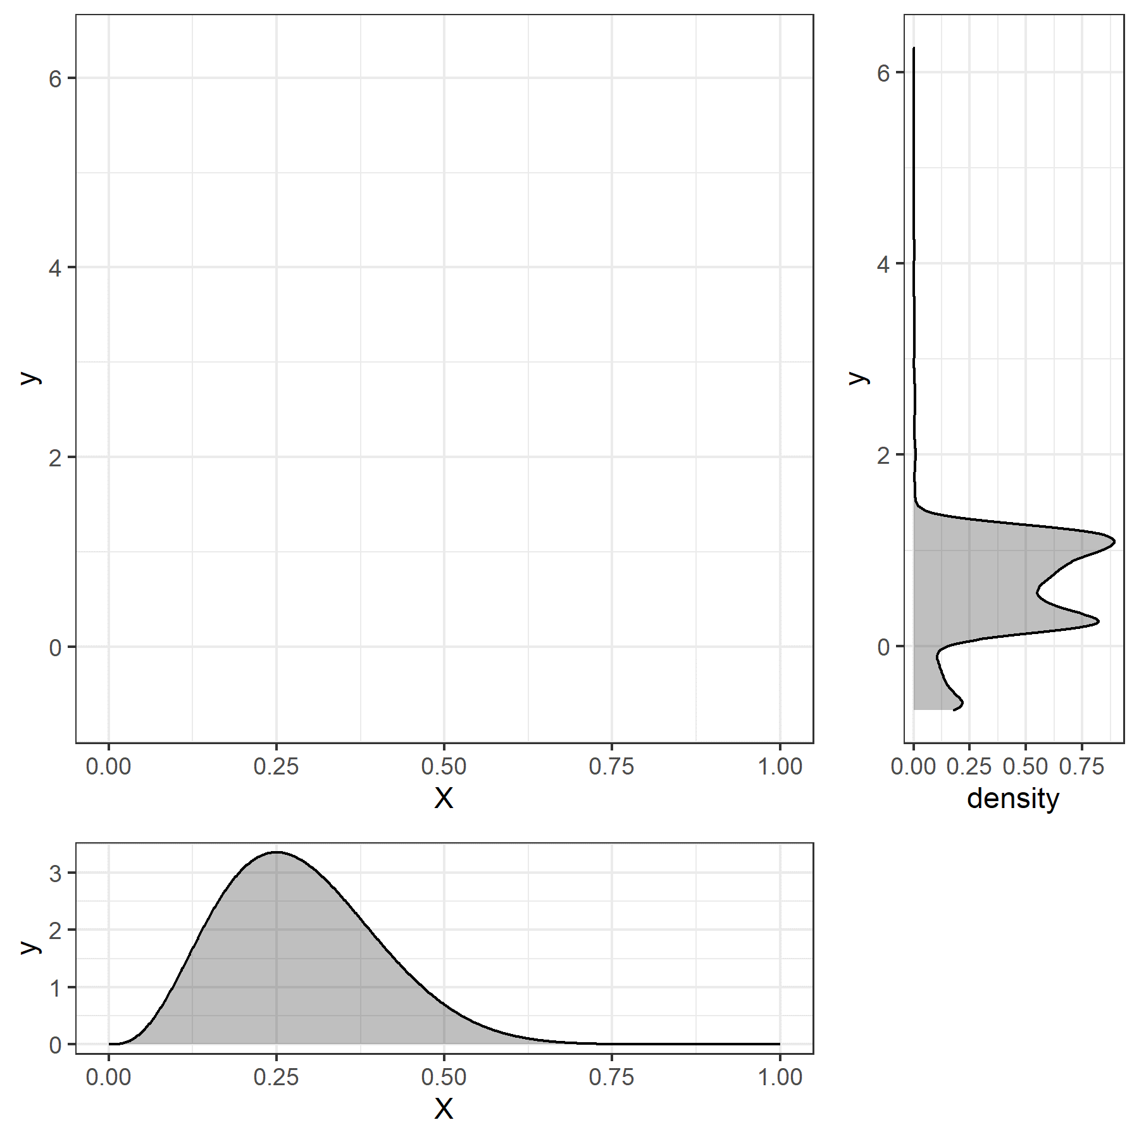
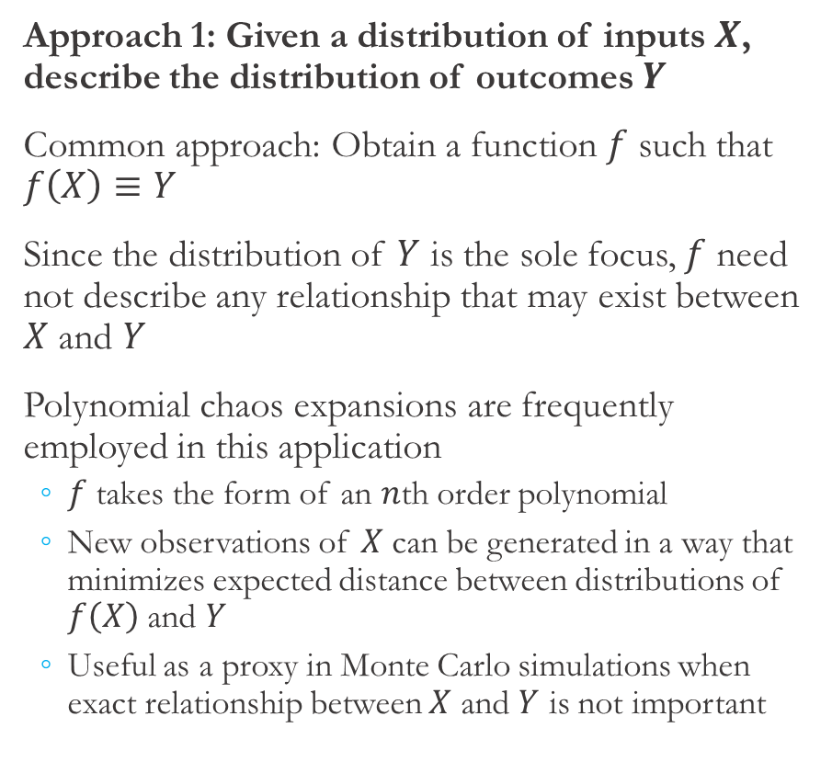
UQ Applications (1)
Approach 1: Given a distribution of inputs $X$, describe the distribution of outcomes $Y$
Common approach: Obtain a function $f$ such that $f\left(X\right)≡Y$
Since the distribution of $Y$ is the sole focus, $f$ need not describe any relationship that may exist between $X$ and $Y$
Polynomial chaos expansions are frequently employed in this application
$f$ takes the form of an $n$th order polynomial
New observations of $X$ can be generated in a way that minimizes expected distance between distributions of $f\left(X\right)$ and $Y$
Useful as a proxy in Monte Carlo simulations when exact relationship between $X$ and $Y$ is not important
Notes:
The first approach is the most basic UQ approach that was alluded to in the previous slide. In this approach, given a distribution of inputs X, we just want to describe the distribution of outcomes Y. So, a common approach is to find some function f such that f applied to X produces a random variable that has the same distribution as Y, which is what’s meant by that equivalency notation.
Now, since the distribution of Y is really the sole focus, the function we’re trying to find doesn’t need to describe any relationship that may exist between inputs and outputs. Of course, if there were a function that did describe the relationship between X and Y that would certainly work here, but there are many other functions that would also fit this task.
So, in this graph we have inputs on the horizontal axis and a distribution of those inputs below, then on the vertical axis we have outputs and the distribution of outputs we’re trying to approximate. So, in the next slide we show one potential function that maps the input distribution to the output distribution.

Slide 16
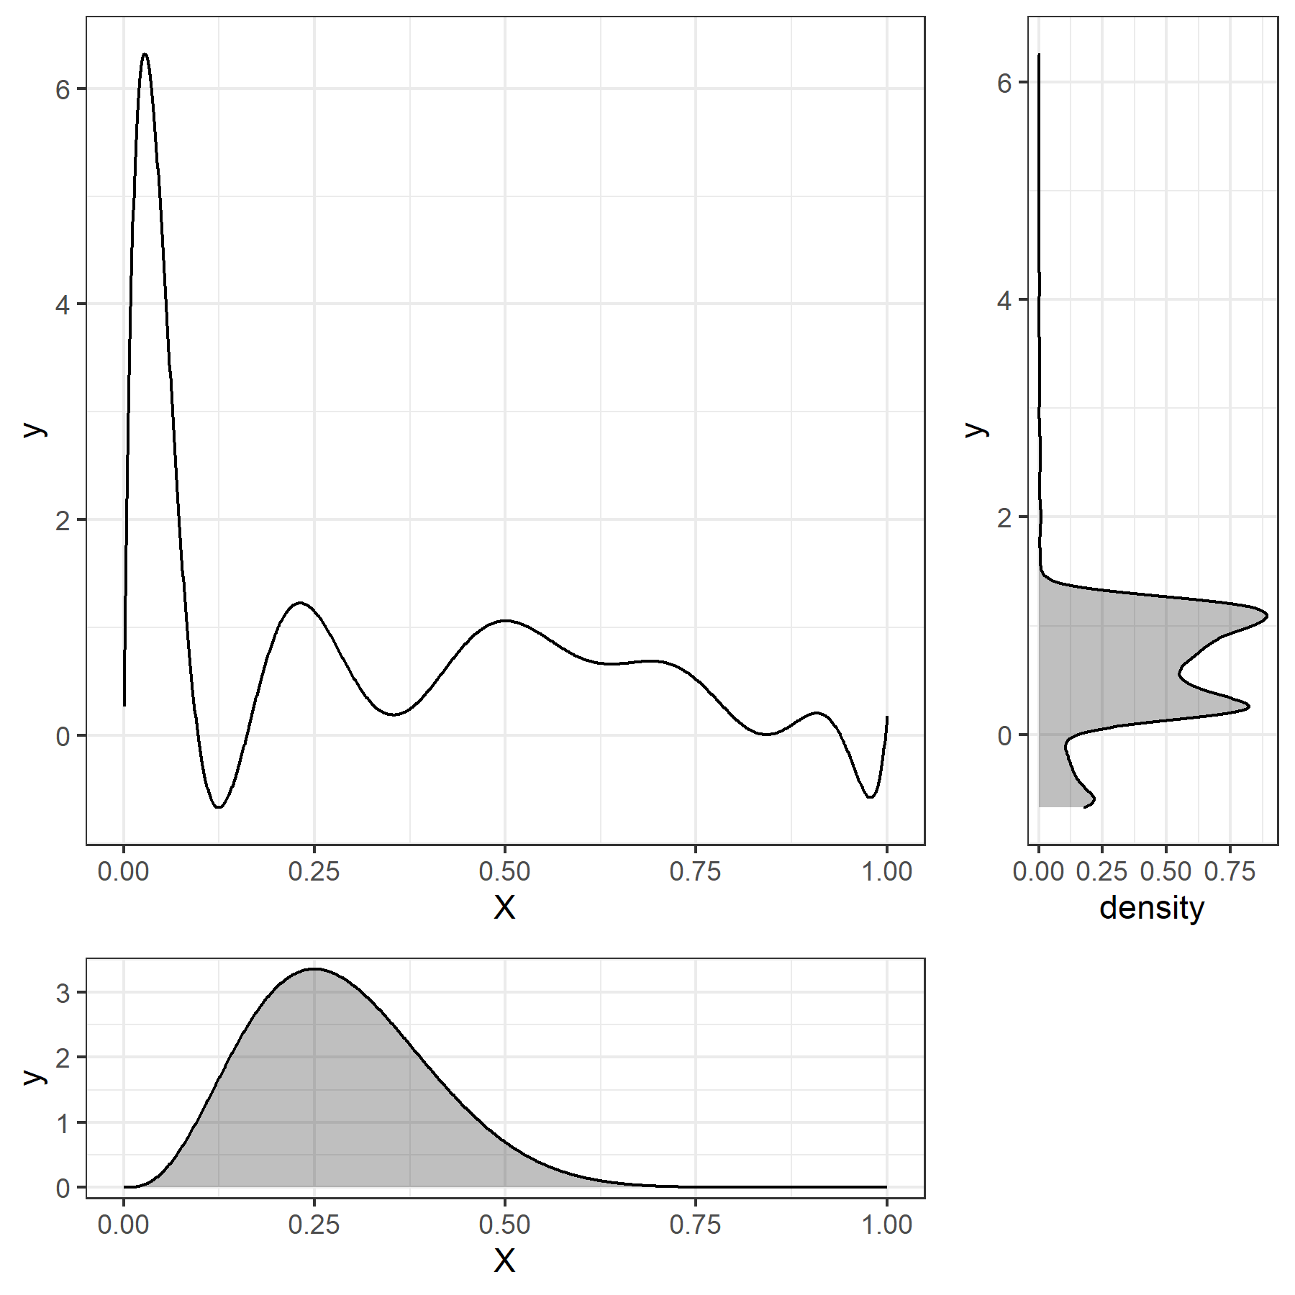
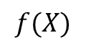
UQ Applications (1)
Approach 1: Given a distribution of inputs $X$, describe the distribution of outcomes $Y$
Common approach: Obtain a function $f$ such that $f\left(X\right)≡Y$
Since the distribution of $Y$ is the sole focus, $f$ need not describe any relationship that may exist between $X$ and $Y$
Polynomial chaos expansions are frequently employed in this application
$f$ takes the form of an $n$th order polynomial
New observations of $X$ can be generated in a way that minimizes expected distance between distributions of $f\left(X\right)$ and $Y$
Useful as a proxy in Monte Carlo simulations when exact relationship between $X$ and $Y$ is not important
$$f(X)$$
Notes:
Now, in a UQ analysis, we would use f to serve as a proxy or surrogate for the actual simulation. So, we would pick values for inputs and, rather than feeding them into the simulation, we would just feed them into f and to draw what is ostensibly a sample of outputs. To identify or approximate such a function, we would evaluate the simulation a finite number of times and use some method to construct an f.
Polynomial chaos expansions are one method that is frequently employed to construct these functions. In that case, f takes the form of a n-th order polynomial and we essentially run a regression of inputs on outputs for the sample we generated. The sample of inputs can either be selected initially to try to effectively span the input space, or it can be adaptively to try to select inputs that would reduce the distance between f(X) and Y the most as information from new observations comes in.
So this approach turns out to be useful for some Monte Carlo simulations when the relationship between X and Y is really not important. In fact, this is how your computer generates draws of normal random variables. It takes a draw of a uniform random variables, then applies a function of logs and sines and cosines to generate a draw from a normal distribution in a computationally-efficient way.

Slide 17
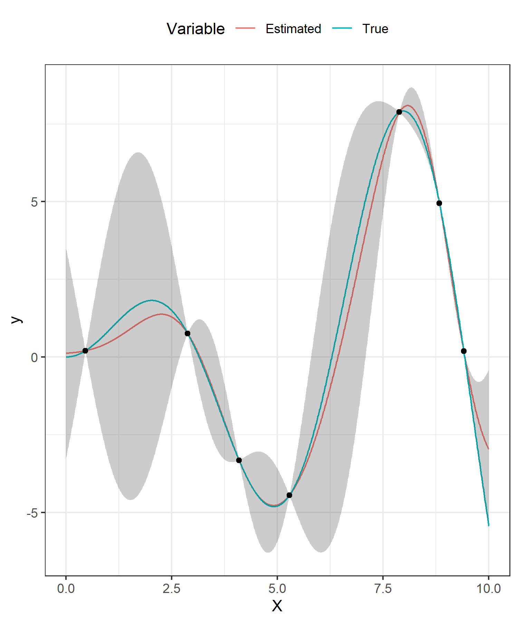
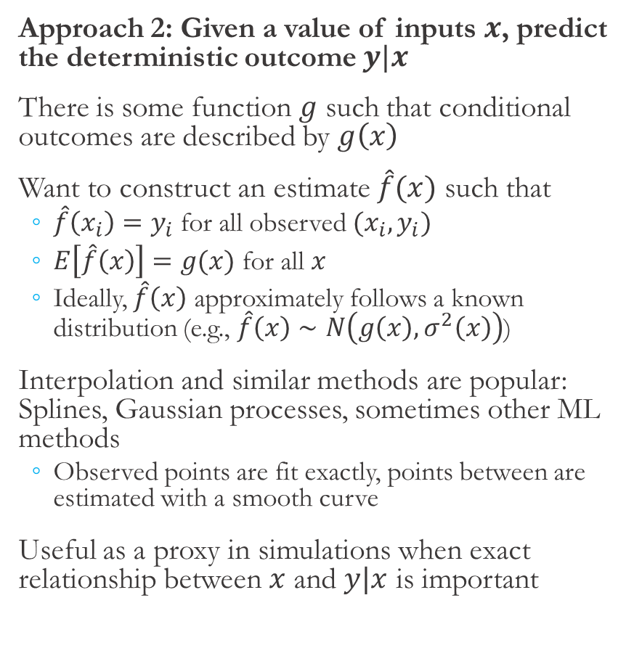
UQ Applications (2)
Approach 2: Given a value of inputs $x$, predict the deterministic outcome $y|x$
There is some function $g$ such that conditional outcomes are described by $g\left(x\right)$
Want to construct an estimate $\hat{f}(x)$ such that
$\hat{f}\left(x_{i}\right)=y_{i}$ for all observed $(x_{i},y_{i})$
$E\left[\hat{f}\left(x\right)\right]=g(x)$ for all $x$
Ideally, $\hat{f}\left(x\right)$ approximately follows a known distribution (e.g., $\hat{f}\left(x\right)∼N\left(g\left(x\right), σ^{2}\left(x\right)\right)$)
Interpolation and similar methods are popular: Splines, Gaussian processes, sometimes other ML methods
Observed points are fit exactly, points between are estimated with a smooth curve
Useful as a proxy in simulations when exact relationship between $x$ and $y|x$ is important
Notes:
In the second approach, there is a deterministic but unknown relationship between X and Y, given here by g, and we want to, given a particular value of inputs, predict the deterministic outcome y|x. So, this is similar to the original use case with deterministic computer simulations. However, again we can only feasible generate a small number of observations from the simulation, so we want to predict and understand uncertainty for intermediate points.
What we’re after in this approach is an estimated function f-hat such that fhat(x) is equal to y for all of the observations in our sample, which should be the case because again the outcome y|x is deterministic. Additionally, for any input values that are not in our sample, we would like the expected of our estimate, fhat(x), to be equal to the true value, g(x). And finally, it’s ideal to have an understanding of prediction uncertainty for those intermediate points, so it’s nice if fhat(x) follows some known distribution like a normal distribution.
In this graph on the right, we have a true relationship between X and Y shown by the blue line, a few selected observations of inputs and outputs from the simulation, an estimated relationship between X and Y shown in red, and estimated 95% confidence intervals on those predictions shown by the shaded region.
Interpolation and similar methods like smoothing are popular here, and these include splines, Gaussian processes which we’ll talk more about, and sometimes some other machine learning methods. So generally, these methods are fitting observed points exactly and are connecting those points with a smooth curve or even some other function that may not be smooth.
So this approach is useful for deterministic simulations where we do actually care to understand the relationship between inputs and outputs.

Slide 18
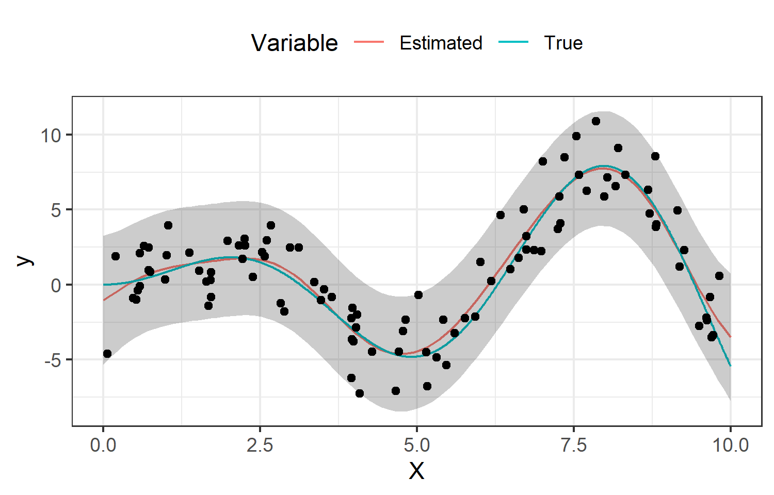
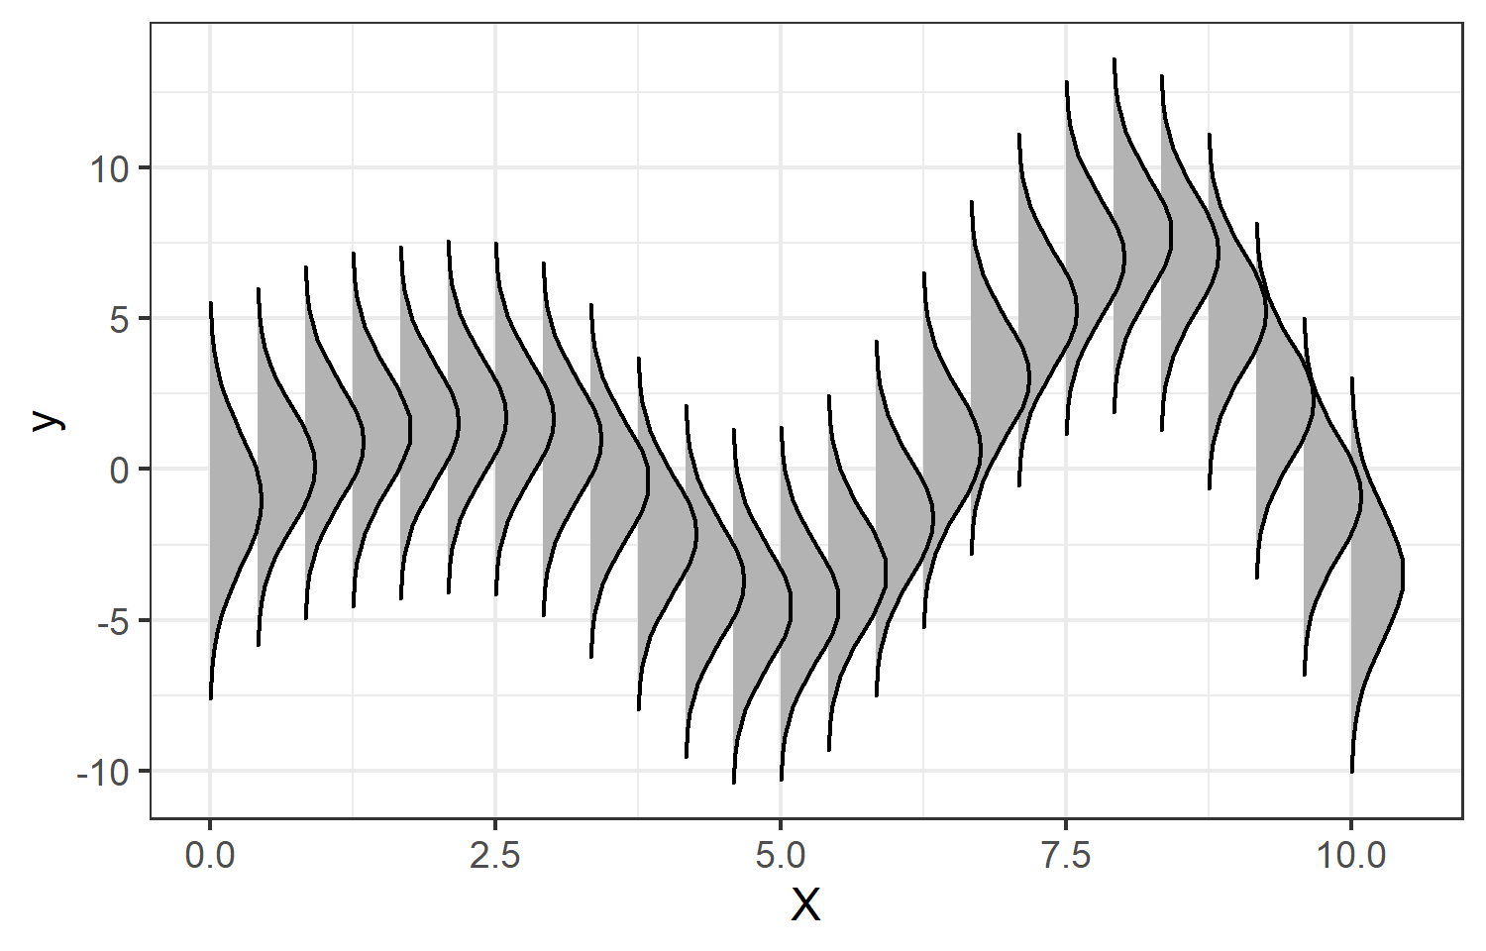
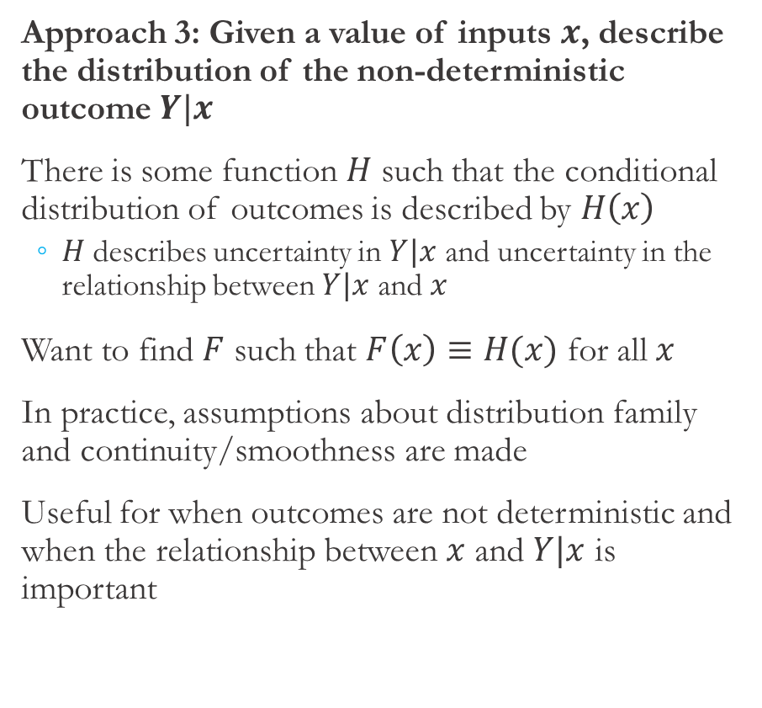
UQ Applications (3)
Approach 3: Given a value of inputs $x$, describe the distribution of the non-deterministic outcome $Y|x$
There is some function $H$ such that the conditional distribution of outcomes is described by $H\left(x\right)$
$H$ describes uncertainty in $Y|x$ and uncertainty in the relationship between $Y|x$ and $x$
Want to find $F$ such that $F\left(x\right)≡H(x)$ for all $x$
In practice, assumptions about distribution family and continuity/smoothness are made
Useful for when outcomes are not deterministic and when the relationship between $x$ and $Y|x$ is important
Notes:
The last approach we’ll cover here refines the previous approach further and does start to blur the line between UQ and statistics. In this approach, the value of outputs conditional on inputs is not deterministic (which is the case for our emulation), and given a particular value of inputs X, we want to approximate the conditional distribution Y|x. So, there is some function H such that H(x) describes the conditional distribution of outcomes. Now, importantly, H describes uncertainty both due to inherent uncertainty in Y|x and uncertainty in the exact relationship between Y and X that comes from having a small number of observations. That is, H describes both aleatoric and epistemic uncertainty.
So, we want to find a function F such that the distribution described by F(x) is the same as that described by H(x). An example of this fit is shown on the right. In the top panel, we again have a true and estimated relationship between X and Y, a number of non-deterministic observations from the emulation, and 95% intervals on observations, which incorporates uncertainty both due to the randomness of Y|X and uncertainty in the relationship between Y and X. To emphasize the objective here, this is shown another way in the bottom panel, where we can pick any value of X and there is an associated distribution of outcomes Y|X.
In practice, we often end up having to make assumptions about the distribution family, continuity or smoothness of the relationship, and possibly assumptions necessary for asymptotic distributions to hold.
So overall, this approach is similar to approach 2 but is useful for when conditional outcomes are not deterministic but we do care about the relationship between X and Y.

Slide 19
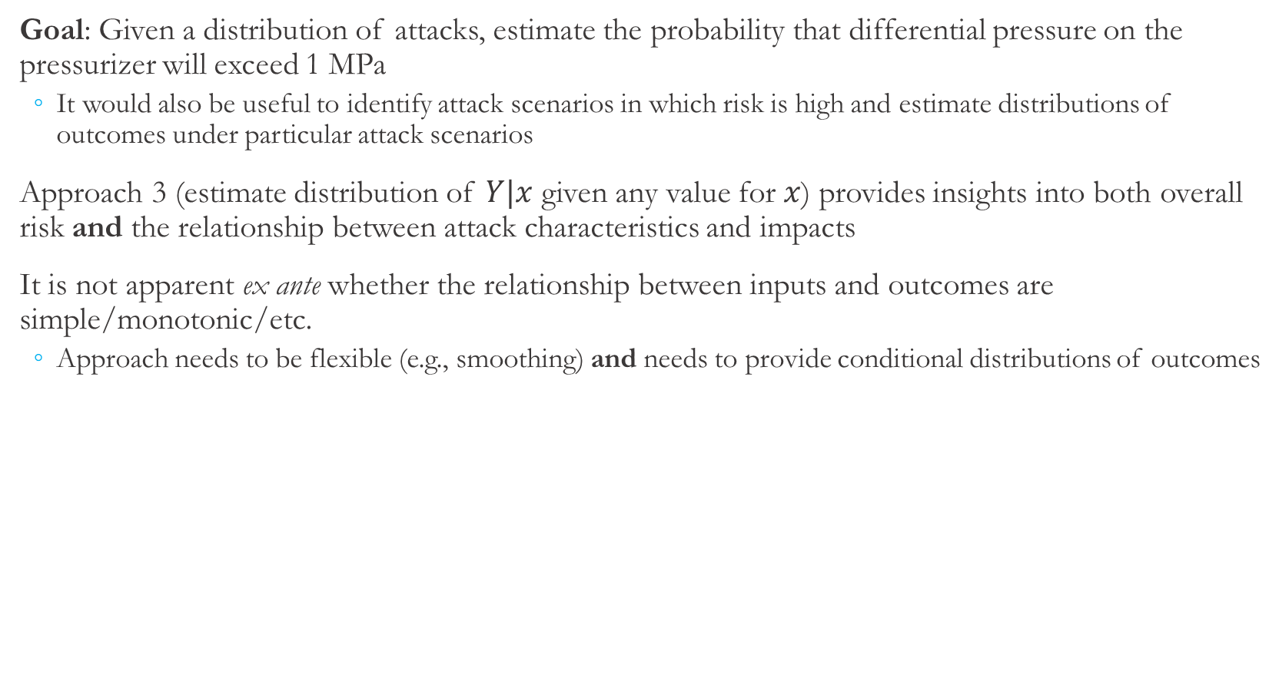
Research Objective and General Approach
Goal: Given a distribution of attacks, estimate the probability that differential pressure on the pressurizer will exceed 1 MPa
It would also be useful to identify attack scenarios in which risk is high and estimate distributions of outcomes under particular attack scenarios
Approach 3 (estimate distribution of $Y|x$ given any value for $x$) provides insights into both overall risk and the relationship between attack characteristics and impacts
It is not apparent ex ante whether the relationship between inputs and outcomes are simple/monotonic/etc.
Approach needs to be flexible (e.g., smoothing) and needs to provide conditional distributions of outcomes
Notes:
Just to recall, our primary goal with this research is, given a distribution of attacks, to estimate the overall probability that differential pressure will exceed 1MPa. If this were absolutely the only thing we cared about, approach 1 would be sufficient here. However, we have secondary goal, because it would be useful to be able to identify particular attack scenarios in which risk is high and potentially estimate distributions of outcomes for particular attack scenarios.
So given both of those goals, approach 3 (which is to estimate the distribution of Y|x given any value of x) was our aspiration, because that would provide insight into both overall risk and the relationship between attack characteristics and impacts. Of course, approach 3 is more intensive, and we have approach 1 to fall back on if for some reason approach 3 didn’t work out.
Further, it’s not really apparent before looking at the data whether the relationship between inputs and outcomes in the emulation is simple or monotonic or otherwise easy to model. So, the approach we chose also needed to be flexible (something like smoothing, which we’ll discuss in the next slide), and it also needs to provide estimates of conditional distributions of outcomes.

Slide 20
Kernel Smoothing and Gaussian Process Approaches

Slide 21
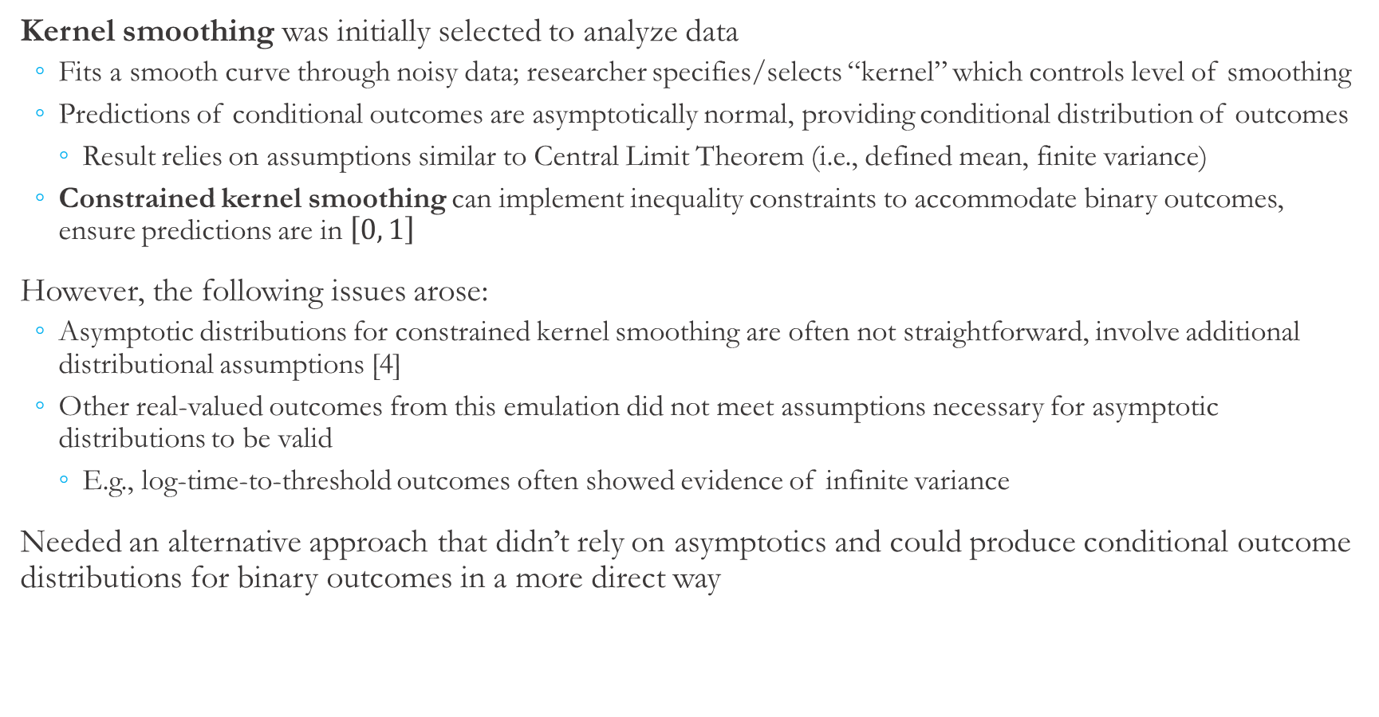
A Failed Approach and Lessons Learned
Kernel smoothing was initially selected to analyze data
Fits a smooth curve through noisy data; researcher specifies/selects “kernel” which controls level of smoothing
Predictions of conditional outcomes are asymptotically normal, providing conditional distribution of outcomes
Result relies on assumptions similar to Central Limit Theorem (i.e., defined mean, finite variance)
Constrained kernel smoothing can implement inequality constraints to accommodate binary outcomes, ensure predictions are in $\left[0, 1\right]$
However, the following issues arose:
Asymptotic distributions for constrained kernel smoothing are often not straightforward, involve additional distributional assumptions [4]
Other real-valued outcomes from this emulation did not meet assumptions necessary for asymptotic distributions to be valid
E.g., log-time-to-threshold outcomes often showed evidence of infinite variance
Needed an alternative approach that didn’t rely on asymptotics and could produce conditional outcome distributions for binary outcomes in a more direct way
Notes:
So now that we’ve talked through what UQ is generally and what we need from a UQ approach in this particular case, let’s talk about some details of what we actually did. So first I’ll talk about kernel smoothing, which initially seemed promising but turned out to be sort of a failed approach.
Given the need for a flexible relationship between inputs and outputs, kernel smoothing was natural first choice of methodology. Broadly, kernel smoothing (and other smoothing methods) fit a smooth curve through noisy data. It’s up to the researcher to select what is called the “kernel” and parameters of the kernel, which control the level smoothing and shape of the fit. Conveniently, for kernel smoothing (and other similar smoothing methods), predictions of conditional outcomes are asymptotically normal, so this method would also give us the conditional outcome distributions we’re after. Now importantly, this asymptotic normality relies on assumptions similar to the Central Limit Theorem; that is, defined mean and finite variance. Finally, regular kernel smoothing is used for real-valued outcomes, but our outcome is binary. Predictions from our chosen method should be between 0 and 1 (and could be interpreted as the probability that an event will occur). Fortunately, there is a refinement of kernel smoothing called constrained kernel smoothing that could be used to constrain predictions to the [0, 1] interval.
We ran into a couple of issues that ultimately caused us to look into other approaches. First, asymptotic distributions for constrained kernel smoothing are not nearly as straightforward as for regular kernel smoothing, and there were some additional assumptions that needed to be made and these methods are not nearly as ubiquitous.
The other issue we ran into was, we had an eye towards using these methods not just for binary outcomes but also for real-valued outcomes, such as the log-time-to-threshold metric, which measures how long it takes to reach the 1MPa threshold, for example. As we looked into those outcomes, we saw they took on fat-tailed distributions. We successfully approximated those outcome distributions with t distributions and were estimating degrees of freedom less than 2, which implies those distributions had infinite variance. So, for those real-valued outcomes, we found ourselves in the somewhat unusual situation of not being able to use the Central Limit Theorem or other asymptotic distributions.
Neither of these issues were complete deal-breakers for kernel smoothing, but it did cause us to look around for other approaches that didn’t rely on asymptotics and could produce conditional outcome distributions for binary outcomes in a more direct way.

Slide 22
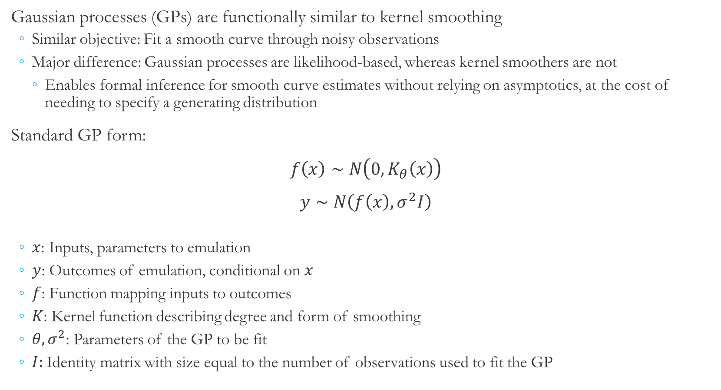
Gaussian Processes
Gaussian processes (GPs) are functionally similar to kernel smoothing
Similar objective: Fit a smooth curve through noisy observations
Major difference: Gaussian processes are likelihood-based, whereas kernel smoothers are not
Enables formal inference for smooth curve estimates without relying on asymptotics, at the cost of needing to specify a generating distribution
Standard GP form:
$f\left(x\right)∼N\left(0,K_{θ}\left(x\right)\right)$
$y∼N\left(f\left(x\right), σ^{2}I\right)$
$x$: Inputs, parameters to emulation
$y$: Outcomes of emulation, conditional on $x$
$f$: Function mapping inputs to outcomes
$K$: Kernel function describing degree and form of smoothing
$θ,σ^{2}$: Parameters of the GP to be fit
$I:$ Identity matrix with size equal to the number of observations used to fit the GP
GP details
Notes:
So this brings us to Gaussian processes, which we ultimately did use for this analysis. Gaussian processes functionally look very similar to kernel smoothing. They both have a very similar objective to fit a smooth curve through noisy data. As we’ll see in a moment, Gaussian processes also have a kernel that controls the level of smoothing. However, the importance difference between Gaussian processes and kernel smoothing is that GPs are entirely likelihood based. In particular, that is to say that GPs assume conditional outcomes follow a specified distribution whereas kernel smoothing does not.
The comparison is very much akin to estimating the mean using a sample average (which is similar to what kernel smoothing does) vs. estimating the mean by assuming data come from a normal distribution and estimating the parameters of that distribution. The former is simpler but relies on asymptotics for the estimate distribution, and the latter requires explicitly assuming the outcome distribution but provides some additional information. So overall this gives us a way to estimate and do formal inference for smooth curve estimates while avoiding some of those asymptotic issues.
The standard GP formulation is shown here. First, we have a function f that maps inputs to expected outputs. f(x), which acts as a latent variable in this model, is assumed to follow a multivariate normal distribution with mean 0 and covariance matrix given by K(x). Here, K is the kernel function, which takes the vector of inputs, x, and returns a covariance matrix. Theta contains the parameters of the kernel function that control the degree of smoothing, and those must be fit using observed data. Also, y are typically standardized (and demeaned in particular), so the assumption of a mean of zero is justified.
Then, the GP also assumes that y follows a normal distribution, with mean given by the predicted value f(x) and variance of sigma squared.

Slide 23
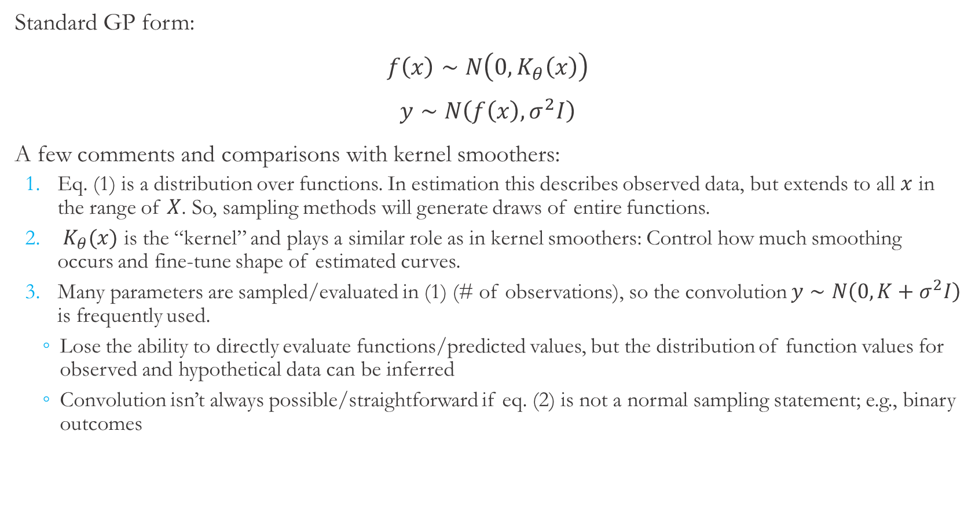
Gaussian Processes vs. Kernel Smoothers
Standard GP form:
$f\left(x\right)∼N\left(0,K_{θ}\left(x\right)\right)$
$y∼N\left(f\left(x\right), σ^{2}I\right)$
A few comments and comparisons with kernel smoothers:
Eq. (1) is a distribution over functions. In estimation this describes observed data, but extends to all $x$ in the range of $X$. So, sampling methods will generate draws of entire functions.
$K_{θ}(x)$ is the “kernel” and plays a similar role as in kernel smoothers: Control how much smoothing occurs and fine-tune shape of estimated curves.
Many parameters are sampled/evaluated in (1) (# of observations), so the convolution $y∼N\left(0, K+σ^{2}I\right)$ is frequently used.
Lose the ability to directly evaluate functions/predicted values, but the distribution of function values for observed and hypothetical data can be inferred
Convolution isn’t always possible/straightforward if eq. (2) is not a normal sampling statement; e.g., binary outcomes
(1)
(2)
GP details
Notes:
Since GPs and kernel smoothers are pretty similar, I wanted to take a couple moments to highlight a few things. First, equation 1 is in fact a distribution over functions. When we’re going through the estimation procedure, f(x) is just a vector of f applied to each element of x, but it does extend to all x. That is to say, we could come up with an arbitrarily long vector for x (with arbitrarily many input points), and this statement will still hold. So, if we’re using a sampling methodology, samples will contain entire functions that are defined by parameters theta.
Second, as mentioned and alluded to before, K is the kernel and plays a very similar to kernel smoothing; that is, to control the degree and shape of estimated curves.
Finally, the model as it is presented here is difficult to work with computationally, especially for large numbers of observations. Frequently, the convolution of equations 1 and 2 is used, which is shown here. The immediate issue with this convolution is we lose visibility of the latent variable f(x), but this is solved using an inferred distribution of function values, which is shown in the backup slides if you’re interested. Now, this convolution isn’t always possible if equation 2 is something other than a normal distribution, such as for binary outcomes as we’ll see in a moment. In that case, GPs can be very computationally-intensive for large numbers of observations, which may warrant looking into other methods.

Slide 24
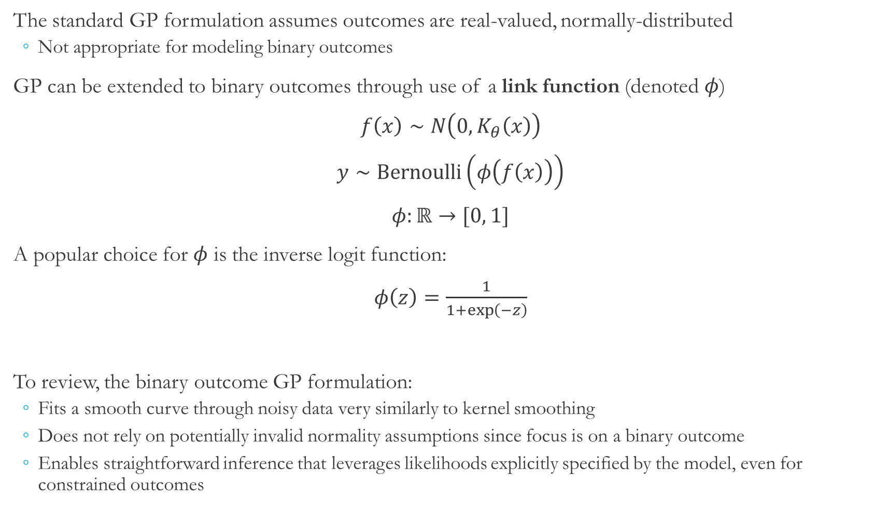
Gaussian Process for Binary Outcomes
The standard GP formulation assumes outcomes are real-valued, normally-distributed
Not appropriate for modeling binary outcomes
GP can be extended to binary outcomes through use of a link function (denoted $φ$)
$f\left(x\right)∼N\left(0, K_{θ}\left(x\right)\right)$
$y∼Bernoulli\left(φ\left(f\left(x\right)\right)\right)$
$φ:ℝ→[0, 1]$
A popular choice for $φ$ is the inverse logit function:
$φ\left(z\right)=\frac{1}{1+\exp\left(−z\right)}$
To review, the binary outcome GP formulation:
Fits a smooth curve through noisy data very similarly to kernel smoothing
Does not rely on potentially invalid normality assumptions since focus is on a binary outcome
Enables straightforward inference that leverages likelihoods explicitly specified by the model, even for constrained outcomes
Notes:
As just alluded to, the standard GP formulation assumes outcomes are real-valued and normally-distributed. Of course, our outcome of interest is binary, so we needed to adapt the standard GP formulation for our particular case. We adopted an approach similar to what is done with generalized linear models. In particular, we use a function that maps the real line to the [0, 1] interval and apply that to predicted values f(x). This transforms the real-valued f(x) into something that is between 0 and 1 and can interpreted as a probability that the event will occur. This is shown here, where y now takes on a Bernoulli distribution (that is, it takes on value of either 0 or 1), and takes on a value of 1 with probability phi(f(x)). There are a couple of popular choices for phi, we opted for the inverse logit shown here.
So, to revie, the binary outcome GP model checks all the boxes of things we were looking for. It fits a smooth curve (constrained to the [0, 1] interval) through noisy data in a flexible way. By using a binary outcome we avoid some of the issues around assuming normality and issues around asymptotics, though the standard GP could be adapted to accommodate non-normality. And finally, this enables very straightforward inference that leverages likelihoods explicitly specified and assumed by the model.

Slide 25
Sampling Procedure
Inputs: Which actuator is targeted, what value(s) are injected to targeted actuator(s)
Emulated PWR System
Heater Actuator
Sprayer Actuator
Outputs: Indicator of whether differential pressure exceeded 1 MPa at any point during the attack
We focus on estimating probability that differential pressure will exceed 1 MPa at any point in the two minute attack, conditional on which actuator is targeted and values injected to targeted actuator(s)
Input samples used to fit the GP were generated with Latin hypercube sampling
Generates a sample of inputs that effectively spans the input space
Sample contained 250 attack scenarios: 83 targeted heater, 83 targeted sprayer, and 84 targeted both
Emulation was run with each input value and outcomes were recorded
Emulation initialized then allowed to stabilize for 5 minutes, followed by a 2 minute attack
Obtaining additional observations is relatively time-intensive
Notes:
So now let’s get into how we generated data using the emulation. Once again, we are focused on estimating the probability that differential pressure will exceed 1 MPa at any point in the two minute attack, conditional on which actuators are targeted and what values are injected to the targeted actuators. We used Latin hypercube sampling to generate our sample of inputs. Latin hypercube sampling is a method that partitions the input space and generates an observation from each of those partitions, which results in a sample that very effectively spans the input space. It is not an adaptive sampling method however, and we’ll discuss some of those implications a bit more later.
The sample used to fit the Gaussian process contained 250 attack scenarios. 83 targeted just the heater, 83 targeted just the sprayer, and 84 targeted both the heater and sprayer. For each of the attack scenarios, we set up emulation and allowed it to stabilize for 5 minutes. We then launched the attack according to attack scenario parameters and let the attack run for two minutes. After that point we stop the emulation; we also could have let the emulation continue after the attack, but the system simply stabilizes after the attack so there’s not any additional information to gain by letting the emulation continue after the attack. So overall, each iteration of the emulation takes around 7 minutes to run, which is relatively time-intensive and motivates our UQ approach. Finally, tthe emulation captured readings of differential pressure, which we used to construct an indicator of whether the 1 MPa threshold was reached.

Slide 26
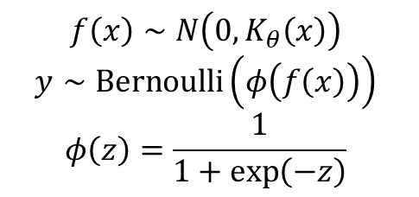
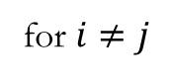
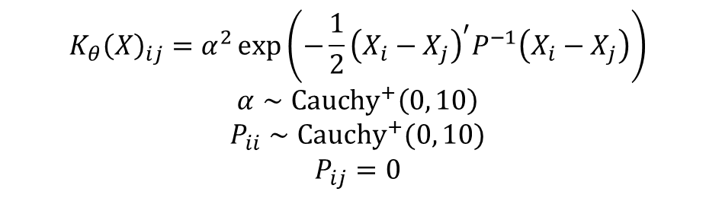
Estimation Issues and Procedure
Potential estimation issue: Binary outcome models can suffer from parameter instability, especially when using more flexible relationships between inputs and outcomes [5]
Can cause convergence issues for classical statistics estimation methods
Bayesian statistics estimation methods offer a solution
Must specify priors over parameters
Convergence can be assessed more reliably (e.g., trace plots/diagnostics)
Following Gelman et al. [6], half-Cauchy priors were assumed for kernel parameters
Model was estimated using No U-Turn Sampling as implemented in the Stan platform [7]
Sampler used 1000 burn-in and 1000 sampling iterations
Trace plots/diagnostics were used to assess convergence of Markov chain
$$f\left(x\right)∼N\left(0, K_{θ}\left(x\right)\right)$$
$$y∼Bernoulli\left(φ\left(f\left(x\right)\right)\right)$$
$$φ\left(z\right)=\frac{1}{1+\exp\left(−z\right)}$$
$$K_{θ}{\left(X\right)}_{ij}=α^{2}\exp\left(−\frac{1}{2}{\left(X_{i}−X_{j}\right)}^{′}P^{−1}\left(X_{i}−X_{j}\right)\right)$$
$$α∼Cauchy^{+}\left(0, 10\right)$$
$$P_{ii}∼Cauchy^{+}(0, 10)$$
$$P_{ij}=0$$
for $i≠j$
Notes:
There’s one final issue we ran into which is concerned with the estimation procedure. When binary outcome models (and especially those that allow a flexible relationship between inputs and outputs) are fit with classical statistics methods like maximum likelihood estimation, there’s a well-known parameter instability issue that can cause convergence problems for those estimation algorithms. This is a related issue to fitting a logit model with many fixed effects that can also cause convergence issues, and the likelihood function can develop a shape (like a flat ridge) that is difficult for optimizers to navigate. So the concern here is that if we were to estimate this with something like maximum likelihood, the optimizer can reach a point where convergence criteria are met, but we’re not actually at the maximum of the likelihood function, and it can be hard to tell if the point the optimizer claims is the maximum is truly the maximum. We noticed this could might problem fairly early on by starting the optimizer off at different initial points at noticing that it ended up claiming to have converged at different points.
So one way to address this and give more confidence in our estimation procedure is to use a Bayesian estimation framework. In a Bayesian framework, the cost is the researcher must specify prior distributions for each parameter. Ideally these priors are selected so that they are less-informative; that is, prior assumptions are not driving the results. So following Gelman et al. we used half-Cauchy distributions for those kernel parameters. Now the benefit of using a Bayesian estimation framework (and in particular Markov chain Monte Carlo) is first and foremost that its really much easier and reliable to assess convergence through the use of trace plots and other diagnostics. The other secondary benefit is that even less-informative priors can make the target distribution (the posterior distribution) a little more well-behaved than the raw likelihood function.
In the blue box we have the entire model. We’ve seen everything in the left column in previous slides. The right column has the kernel function and priors over the parameters of the kernel function. One thing to note, we did assume the covariance matrix P in the kernel was diagonal, which implies we’re assuming there’s no interaction between values injected to the heater and sprayer. This may seem surprising but is actually a justified assumption for our particular scenario. We’ll see this in the next slide but the long story short is that the heater really didn’t matter, at least for a 2 minute attack.
We did use Markov chain Monte Carlo to estimate the model, and in particular we used No U-Turn Sampling as implemented in the Stan platform. So how Markov chain Monte Carlo works is, you set up a Markov chain, and you let it run for enough iterations until the Markov chain is approximately at its steady state. And it turns out that by construction, that steady state distribution is the posterior distribution, so additional iterations are sampled from the posterior as desired. We used 1000 burn-in iterations to get our Markov chain close to convergence, and then used 1000 sampling iterations to generate samples of model parameters. Of course, we also used trace plots and other diagnostics to make sure convergence had been achieved.

Slide 27
Results

Slide 28
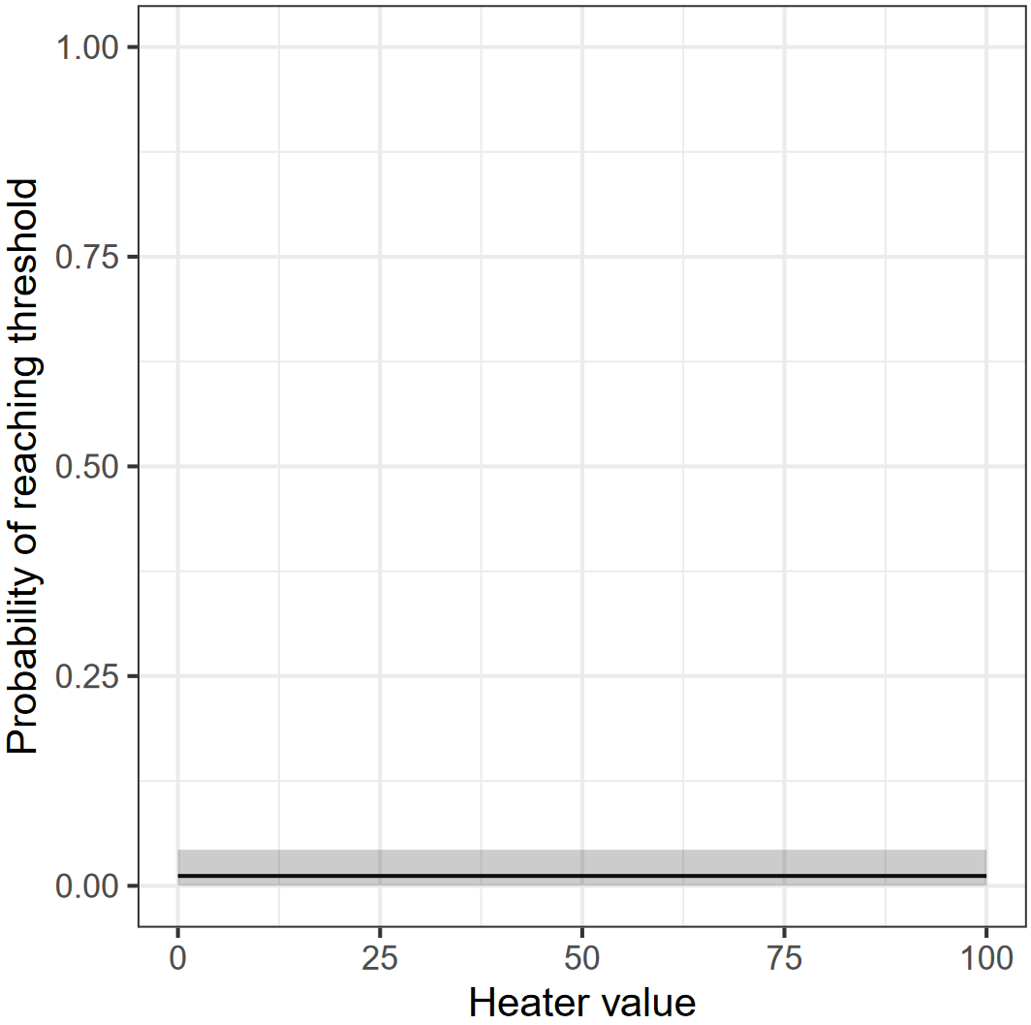
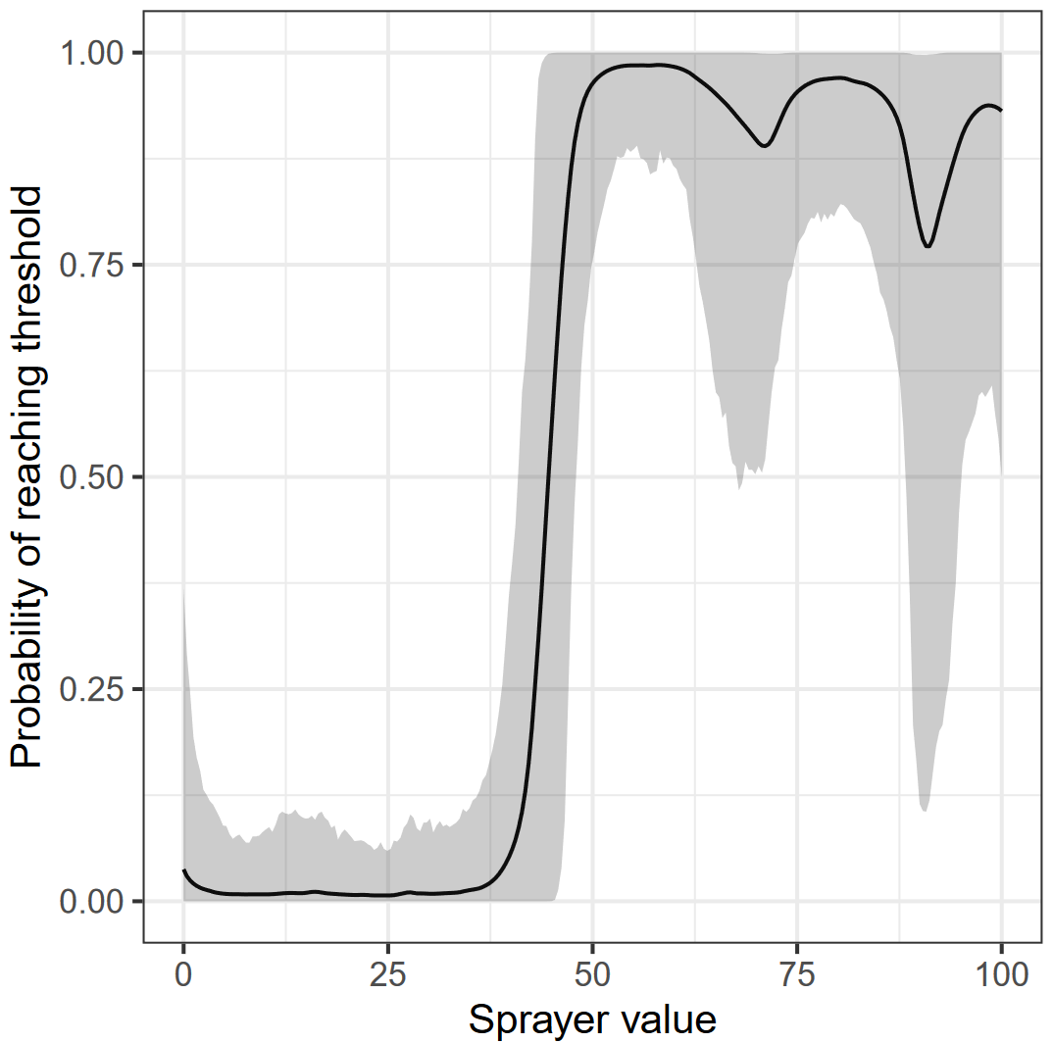
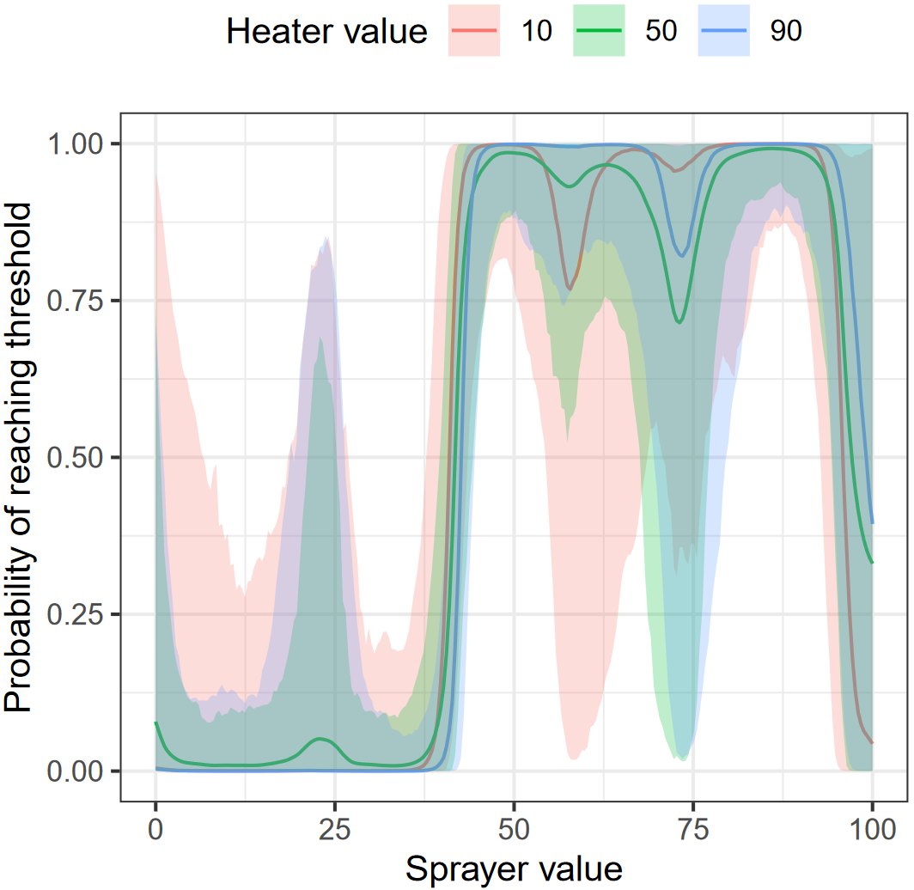
Conditional Probability Estimates
Probability of reaching 1 MPa threshold when only the heater actuator is targeted, conditional on values injected to heater actuator
Probability of reaching 1 MPa threshold when only the sprayer actuator is targeted, conditional on values injected to sprayer actuator
Probability of reaching 1 MPa threshold when both actuators are targeted, conditional on values injected to both actuators
Notes:
Now, moving on to results. These plots show our estimates of the conditional probability that the 1MPa threshold would be reached conditional on which actuators were targeted and what values were injected to targeted actuators. The left plot shows the scenario in which just the heater is targeted. This was actually a special case, there were zero instances where the threshold was reached when just the heater was targeted regardless of what value was injected to the heater. Since there were zero instances of failure here, the Gaussian process actually had convergence issues. So we ended up using a Beta distribution formulation for the heater case, and there’s more details of that in the paper. Overall, this first plot was our first indication that the heater didn’t really matter for our scenario.
The middle plot shows probability of failure estimates and 95% interior intervals when just the sprayer was targeted. A couple of things we can note: First, there appears to be a threshold on sprayer values around 40 to 45 or so, where injected values below that don’t seem to cause issues, but values above that really do. And what’s happening for those higher values is: The adversary is causing the sprayer to over-actuate, which cools the pressurizer and causes pressure to quickly drop (which would likely result in water flashing to steam in the system). So this is telling us, an attack that over-actuates the sprayer is a very effective and fast way of causing catastrophic events. The second thing we can note from the middle plot is we can start to see some evidence of overfitting, which we’ll talk a bit more about in a minute.
Finally, the third plot shows estimated failure probabilities when both heater and sprayer are targeted. Values injected to the sprayer are shown on the horizontal axis and heater values are shown by different curves, red is 10, green is 50, and blue is 90. This looks qualitatively pretty similar to the sprayer plot. Again we have a threshold around a sprayer value of 40 to 45. And the curves look very similar across heater values, which is again an indication that heater values are not really important in this particular attack scenario.

Slide 29
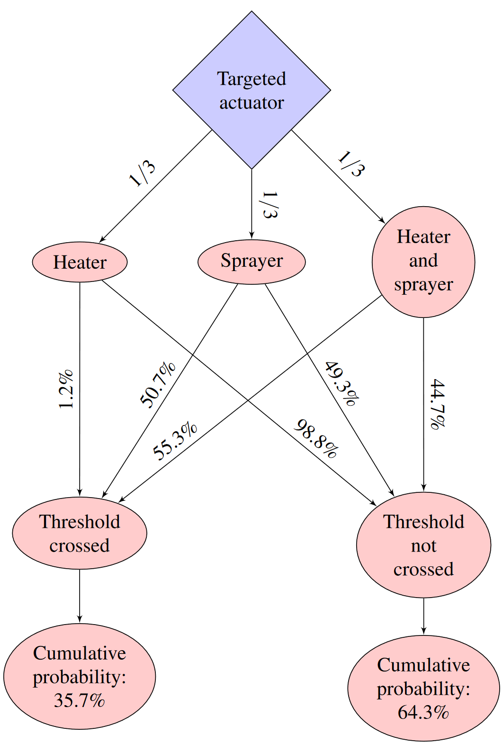
Overall Probability Estimates
Fitted GP used to estimate overall probability of crossing 1 MPa threshold
Heater actuator, sprayer actuator, and both actuators targeted with 1/3 probability each
Values injected to targeted actuator(s) uniformly distributed on [0, 100]
GP surrogate function provides computationally feasible method of approximating these probabilities
Each iteration of the emulation takes 5 minutes to set up/stabilize + 2 minutes for attack
Each sample of the GP takes ~0.7 seconds (3.5 GHz processor)
Notes:
Now finally, we can also use the fitted Gaussian process to estimate the overall probability of crossing the one MPa threshold. Recall that the adversary targets the heater actuator, sprayer actuator, and both actuators each with probability 1/3, and values injected to targeted actuators are uniformly distributed on the interval from 0 to 100. We constructed an event tree, which is shown in this figure on the right. Overall, given assumptions about the attack, we estimate there is a 35.7% probability the threshold will be crossed given the attack occurs, and importantly this estimate incorporates our uncertainty about those failure probabilities. We can also note, again, that when the just the heater is targeted, it’s very unlikely the threshold will be crossed. When just the sprayer is targeted the probability of crossing the threshold is about 50%. And finally, when both heater and sprayer are targeted, there’s about a 55% chance of crossing that threshold.
Finally, using a Gaussian process is really what enables us to approximate these probabilities in computationally feasible and efficient way. Again recall that each iteration of the emulation takes around 7 minutes, whereas drawing a new sample from the Gaussian process takes only 0.7 seconds.

Slide 30
Discussion and Impacts

Slide 31
Methodological Extensions
Investigation of analytical methods other than GPs
Constrained kernel smoothing + bootstrapping for binary outcomes
Alternative forms of GP model
Problem: Results show some evidence of overfitting
Indicates that estimate uncertainty may be under-quantified, increasing bias in estimates
Potential solutions:
Adaptive sampling to focus on regions where overfitting appears to have occurred
Impose constraints such as monotonicity where justified
Alternative priors to “force” greater prediction uncertainty (last resort)
Alternative sampling methodologies to boost overall UQ/GP efficiency
Extension to real-valued outcomes
Problem: Fat-tailed distributions for some real-valued outcomes complicate asymptotics
Requires more explicit modeling of outcome distributions, which can be more difficult to work with computationally/numerically
Notes:
So, this research gave us a good case study of how to leverage emulation together with uncertainty quantification to begin to measure risk posed by range or distribution of attack scenarios or even particular attack scenarios. However, there were a few things that came that could use either further investigation or refinement.
First, we initially turned to Gaussian processes (after considering kernel smoothing) because there is a precedent of using GPs in uncertainty quantification. That said, Gaussian processes are not necessarily the only method one could use here. In particular, when we were looking through constrained kernel smoothing literature, bootstrapping came up as one potentially very useful method for our application. And, in short, it’s convenient because it avoids asymptotics by design, but wouldn’t require specifying a generating distribution (which is the major assumption that has to be made with Gaussian processes). Bootstrapping still hasn’t seen a lot of use in these uncertainty quantification methods though, but it does certainly seem promising.
Next, we noted that the results showing predicted probability of failure showed some evidence of overfitting, notably we could see those dips in the predicted failure probabilities where there was an observed zero. Now the real analytical issue here is that there’s a definite bias-variance tradeoff in the Gaussian process. So, when we look before and after those dips, the Gaussian process is very certain that the failure probability is near one. Then the dips show us that GP was probably too confident and that the estimate was also probably biased. So, there’s definitely room for improvement in those regions and there are a couple of potential ways to refine the model and address the issue. First, as we just noted, the issue is the Gaussian process doesn’t have a great understanding of uncertainty around those dips. So one thing we could do is give the GP more information by giving it additional observations in those areas. This is a form of adaptive sampling, and we did actually eventually employ this with a lot of success, confidence bands grew and dips were smoothed out as expected.
For another option, it became clear in looking through results that there is probably a monotonic relationship between values injected to the sprayer and probability of failure. And this hypothesis does make sense from the system perspective. So, like constrained kernel smoothing, monotonicity constraints can be imposed on Gaussian processes. So if we have good reason to believe that assumption, this would directly ensure that those dips cannot exist and should also widen confidence bands.
Finally, and really as a last resort, we could make our priors over kernel parameters more informative to sort of force greater uncertainty in our predictions. Generally we don’t like to make priors informative in a Bayesian framework, but again these kernel are controlling the level of smoothing and the fitted curve is not smooth enough. So, we can very directly get to the issue through the priors, and there is precedent for the researcher having some control over smoothing parameters.
Next, we ultimately looked at a couple of sampling methodologies but didn’t real dive into other methods that might perform even better. The bit of adaptive sampling we did proved very effective, so it definitely could be worthwhile to think about how samples are generated.
Finally, there were also real-valued outcomes we were interested in describing, such as log-time-to-threshold. Again the issue here is these outcome distributions can have fat tails that can really complicate asymptotics. There’s a couple of ways to address this, including bootstrapping as mentioned above, and explicitly modeling the outcome distribution, which can certainly be more difficult to work with computationally and numerically.

Slide 32
Impacts
Lessons learned and informing UQ cyber emulation analyses for other applications
Assumptions supporting asymptotics may not be valid for real-valued outcomes. Methods that avoid asymptotics are preferable (possibly necessary). Candidates include Gaussian processes and bootstrapping.
Reframing outcomes can be useful to avoid difficult distributional assumptions and simplify analysis
E.g., can real-valued outcomes be transformed into binary/categorical indicators and still capture important information?
This proof-of-concept model was extended to be more representative of actual PWR systems, directly useful to DOE-NE sponsor
Consider intrusion detection/prevention systems on SCADA network
Utilize previous threat/vulnerability analyses and intelligence to develop more sophisticated/realistic distribution of attacks
Notes:
So, this research had impacts of areas. First, as we talked about through this presentation, there were several lessons we learned through this process that helped think through uncertainty quantification for cyber emulation in general. Really the biggest lesson learned was that assumptions supporting asymptotics like the Central Limit Theorem are not always supported and it is really important to check those assumptions, even though they’re very frequently something we take for granted. In those cases, we need to use methods that don’t rely on asymptotics, and we showed here that Gaussian processes are a potential candidate, bootstrapping is also worth considering.
We also saw in this research that reframing outcomes can be really in simplifying analysis, and sometimes you really don’t lose much useful information by reframing outcomes. In particular, in this analysis, we started with a time-to-threshold outcome, but what we were really interested in was whether the threshold was reached or not. So rather than having a real-valued outcome, we really only needed a binary outcome, which allowed us to completely dealing with those fat-tailed distributions for this particular case. So, it’s definitely worthwhile to really consider what outcomes matter because some outcomes are easier to quantify than others.
Further, the proof-of-concept model of the cyber-physical PWR system was extended to more representative of specific actual PWR systems and more directly useful for our DOE-NE sponsor. First, we have the ability to incorporate intrusion detection and prevention systems into our emulation of the SCADA network. SCADA networks historically really haven’t included those protection systems, but this platform let us dive into that question more and consider the tradeoffs. Further, as mentioned before, the attack scenarios we used were pretty simple, and we drew on a variety of sources to develop a more sophisticated and realistic distribution of attacks. And of course the analytical process is very similar, but that gives us a better understanding of actual risk.

Slide 33
Acknowledgements
Thanks to Eric Vugrin, Robert Bruneau, Meg Galiardi, Amanda Gonzales, Jamie Thorpe, Ray Fasano, Tim Ortiz, and Ryan Kao
Work made possible by funding from DOE-NE Cyber Security for Nuclear Facilities
Notes:
We would like to thank Eric Vugrin and Robert for their leadership and thoughtful suggestions, Meg Galiardi, Amanda Gonzales, and Jamie Thorpe for their help with our UQ experiments, Ray Fasano for the PWR Simulink model and model description, and Tim Ortiz and Ryan Kao for the minimega model of the cyber system.
Finally, this work was made possible by funding from DOE-NE Cyber Security for Nuclear Facilities.

Slide 34
References
[1] McKenzie, T., Tarman, T., and Lamb, C., 2020. “Uncertainty quantification for cyber-physical PWR experiments”. Proceedings of the 28th Annual International Conference on Nuclear Engineering.
[2] Sandia National Laboratories, 2019. SCEPTRE: SCADA as a Platform.
[3] Nuclear Energy Institute, 2022. U.S. Nuclear Operating Plant Basic Information.
[4] Cai, T., Low, M., and Xia, Y., 2013. “Adaptive confidence intervals for regression functions under shape constraints”. The Annals of Statistics, 41(2), pp. 722-750.
[5] Allison, P., 2009. “Fixed effects regression models”. SAGE Publications.
[6] Gelman, A., et al., 2006. “Prior distributions for variance parameters in hierarchical models (comment on article by Browne and Draper)”. Bayesian Analysis, 1(3), pp. 515-534.
[7] Stan Development Team, 2018. “RStan: The R interface to Stan”. R package version 2.18.2.

Slide 35
Comments/Questions

Slide 36
Backup Slides

Slide 37
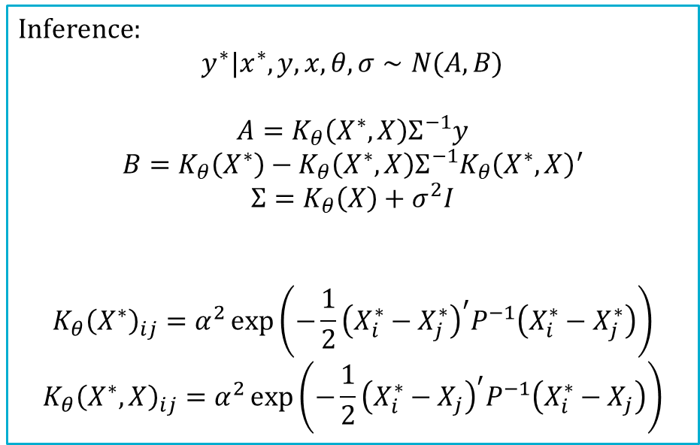
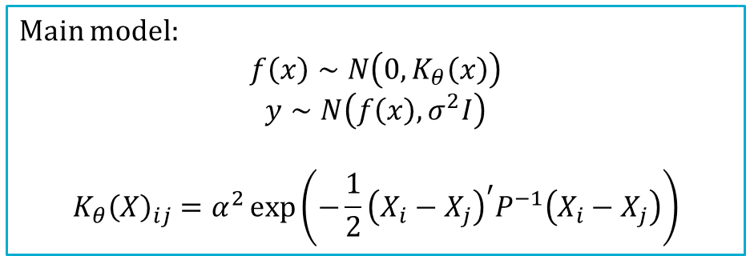

Gaussian Process Details
Main model:
$$f\left(x\right)∼N\left(0,K_{θ}\left(x\right)\right)$$
$$y∼N\left(f\left(x\right), σ^{2}I\right)$$
$$K_{θ}{\left(X\right)}_{ij}=α^{2}\exp\left(−\frac{1}{2}{\left(X_{i}−X_{j}\right)}^{′}P^{−1}\left(X_{i}−X_{j}\right)\right)$$
Inference:
$$y^{∗}|x^{∗},y,x,θ,σ∼N(A, B)$$
$$A=K_{θ}\left(X^{∗},X\right)Σ^{−1}y$$
$$B=K_{θ}\left(X^{∗}\right)−K_{θ}\left(X^{∗}, X\right)Σ^{−1}K_{θ}{\left(X^{∗}, X\right)}^{′}$$
$$Σ=K_{θ}\left(X\right)+σ^{2}I$$
$$K_{θ}{\left(X^{∗}\right)}_{ij}=α^{2}\exp\left(−\frac{1}{2}{\left(X_{i}^{∗}−X_{j}^{∗}\right)}^{′}P^{−1}\left(X_{i}^{∗}−X_{j}^{∗}\right)\right)$$
$$K_{θ}{\left(X^{∗},X\right)}_{ij}=α^{2}\exp\left(−\frac{1}{2}{\left(X_{i}^{∗}−X_{j}\right)}^{′}P^{−1}\left(X_{i}^{∗}−X_{j}\right)\right)$$
(1)
(2)
Dimension reduction using convolution:
(1) + (2) $⇒$
$$y∼N\left(0, K_{θ}(x)+σ^{2}I\right)$$
Return to main presentation

